Slide 1
DEVETECH ELECTRONICS LIMITED

Slide 2
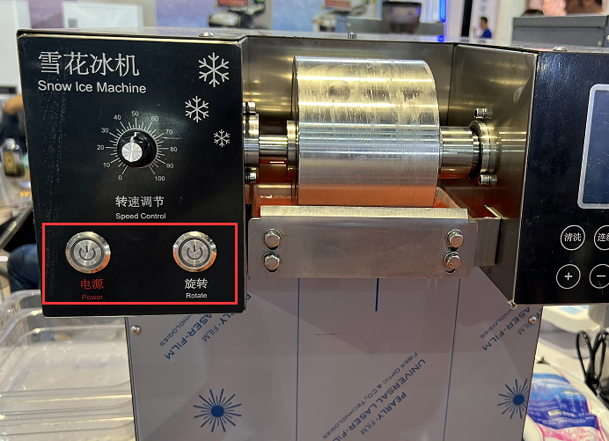
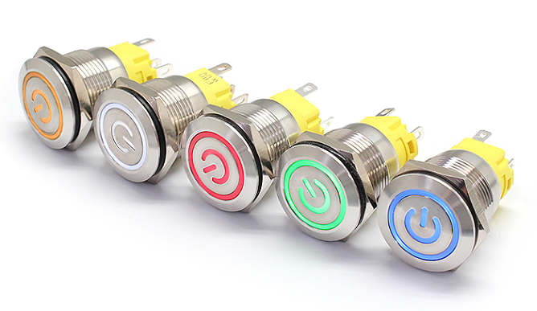
Equipment Name: Snow Ice Machine
Parts:
Push Button Switch like 19mm or 22mm size.
Part Number:
19mm Size: DVFLM19-FJ-1-EC003
22mm Size: DVFLM22-FJ-1-EC003

Slide 3
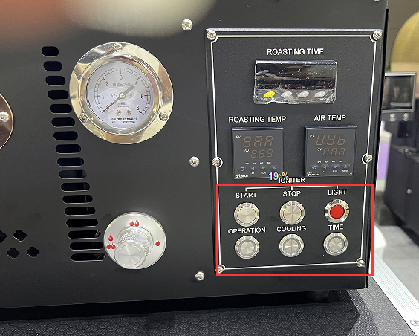
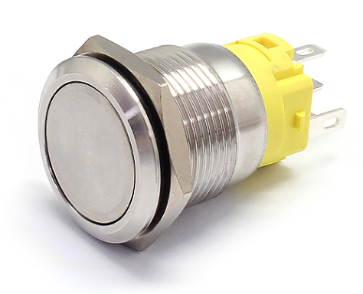
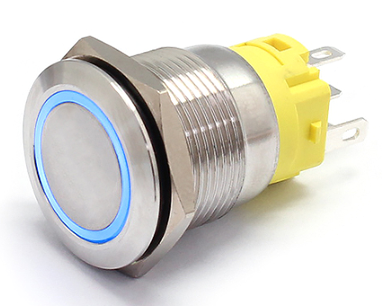
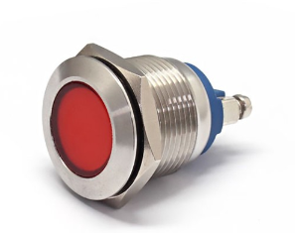
Equipment Name: Grinder
19mm Push Button Switch
Part Number: DVFLM19-FJ-1-XX000
19mm Push Button Switch
Part Number: DVFLM19-FJ-1-EX000
19mm Metal Indicator Light
Part Number: DVFL1M-19FS-1
Also have solder pins.
Parts:
19mm Push button switch
19mm Metal Indicator light

Slide 4
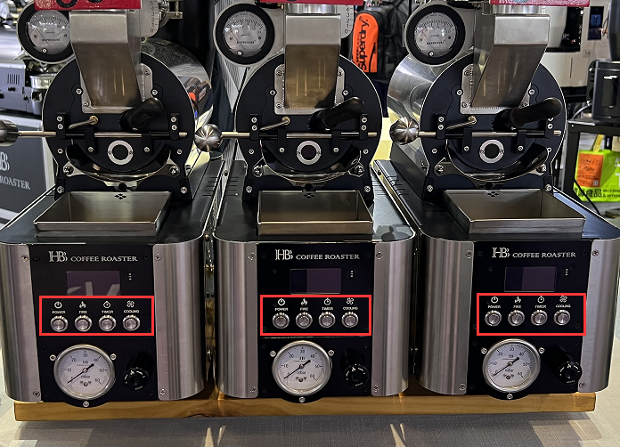
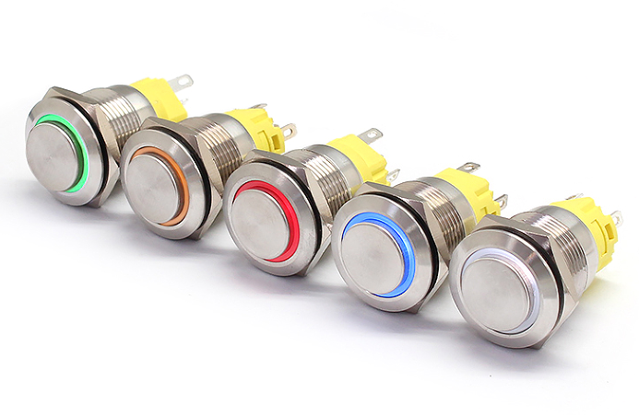
Equipment Name: Coffee Roaster
Parts:
19mm Push button switch
19mm Push Button Switch
Part Number: DVFLM19-HJ-1-EX000

Slide 5
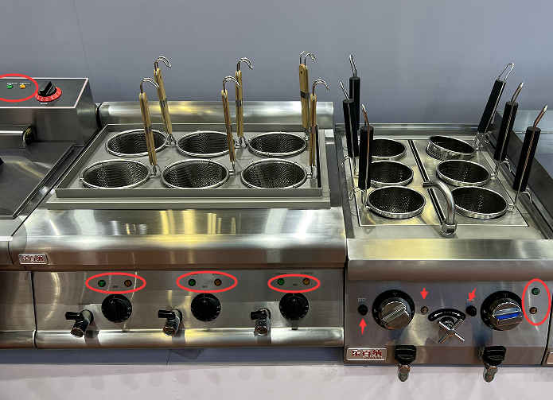
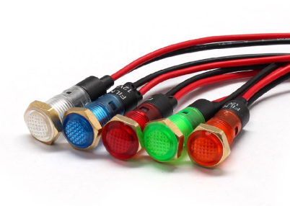
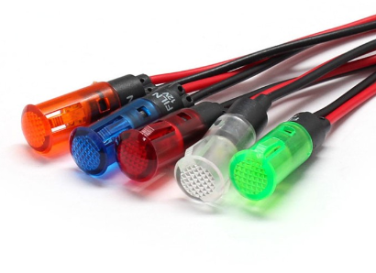
Equipment Name: Deep Fryer
8mm Plastic Indicator light
Part Number: DVFL1P-8NW-1
Screw Connecting Way
8mm Plastic Indicator light
Part Number: DVFL1P-8QW-1
Snap In Connecting Way
This one used much
Parts:
8mm size plastic Indicator light

Slide 6
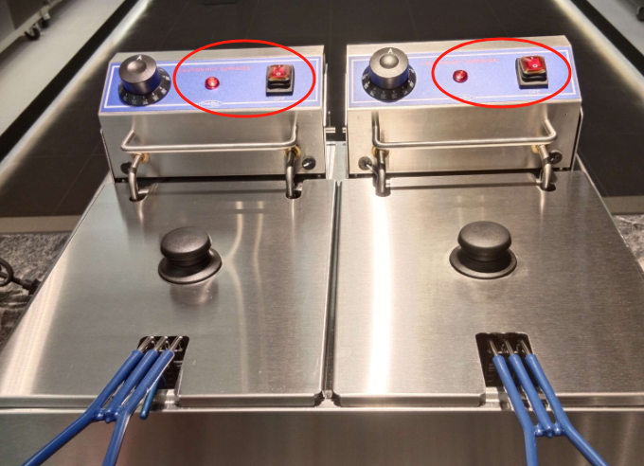
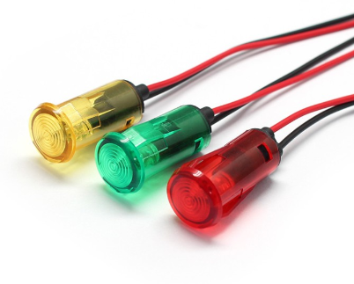
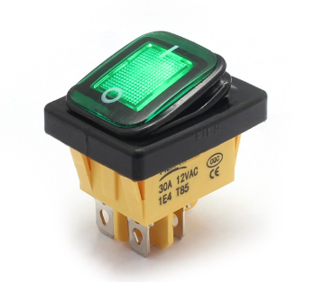
Equipment Name: Deep Fryer
14mm Plastic Indicator light
Part Number: DVFL1P-14QW-1
Snap in Connecting Way
KCD4 Rocker Switch
Part Number: DVKCD4-0121-21
22*30mm size, ON-OFF
Parts:
KCD4 Rock Switch
14mm Plastic Indicator light

Slide 7
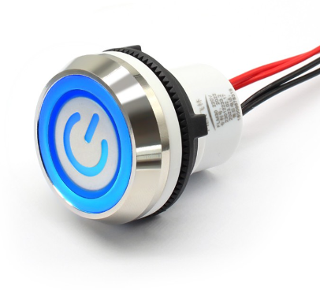
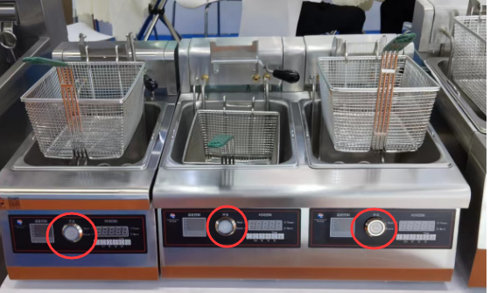
Equipment Name: Deep Fryer
30mm Plastic Push Button Switch
Part Number: DVFLP30-FW-1-EC003
With Wire Leading Directly
Parts:
30mm Plastic Push Button Switch With Wire Leading

Slide 8
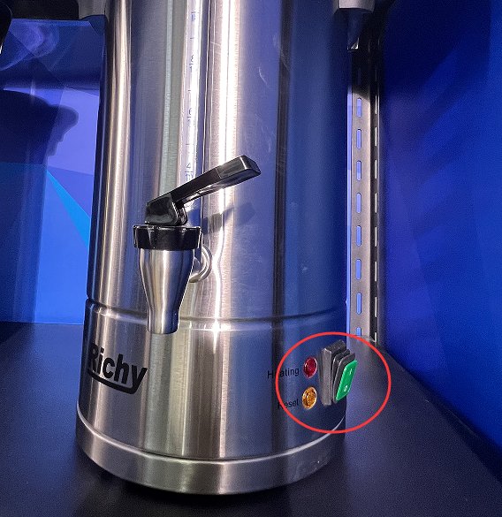
Equipment Name: Water Heater
8mm Plastic Indicator light
Part Number: DVFL1P-8QW-1
Snap In Connecting Way
KCD4 Rocker Switch
Part Number: DVKCD4-0121-21
22*30mm size, ON-OFF
Parts:
D4 Rocker Switch
8mm plastic indicator light

Slide 9
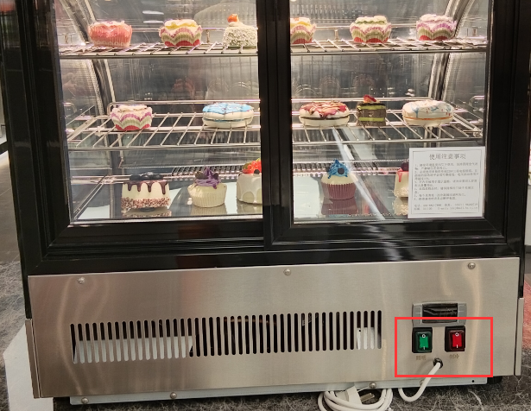
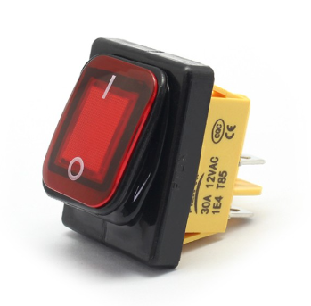
Equipment Name: Crispers
KCD4 Rocker Switch
Part Number: DVKCD4-0121-21
22*30mm size, ON-OFF
Parts:
KCD4 Rock Switch

Slide 10
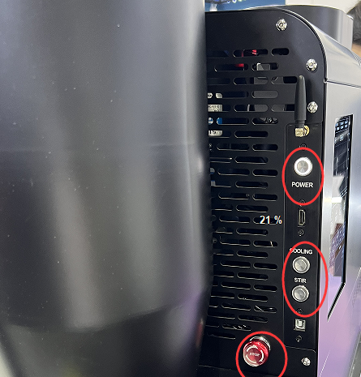
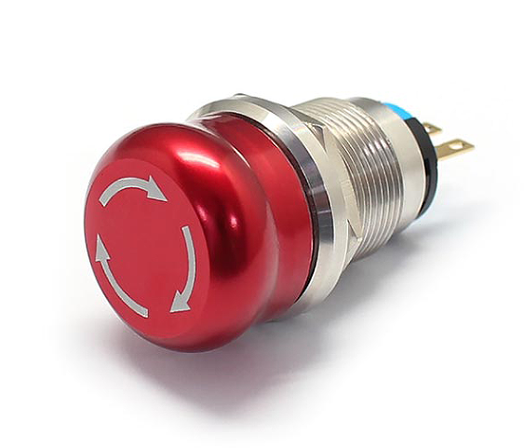
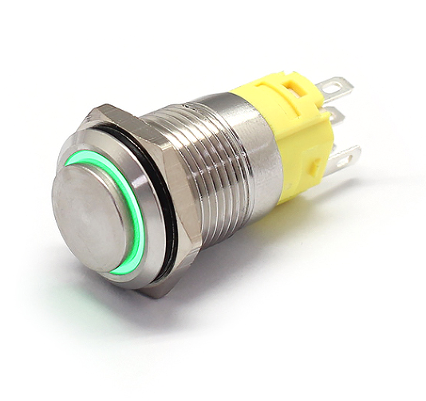
Equipment Name: Ice Steam
19mm Emergency Stop Switch
Part Number: DVFLM19-MJ-1
Screw Connecting Way
16mm Push Button Switch
Part Number: DVFLM16-HJ-1-EX000
Parts:
19mm Emergency Stop Switch
16mm Push Button Switch

Slide 11
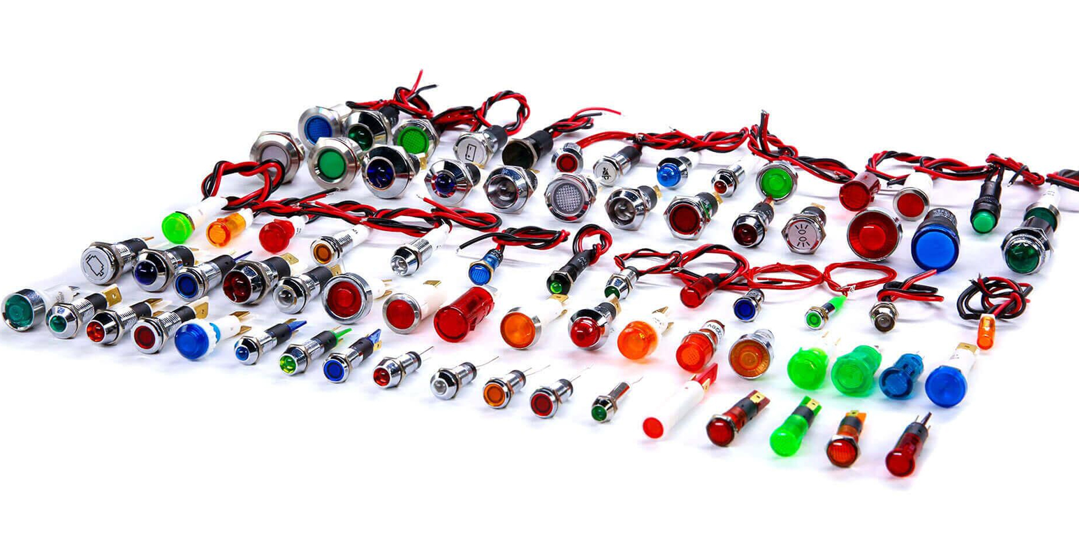
INDICATOR LIGHT SERIES

Slide 12
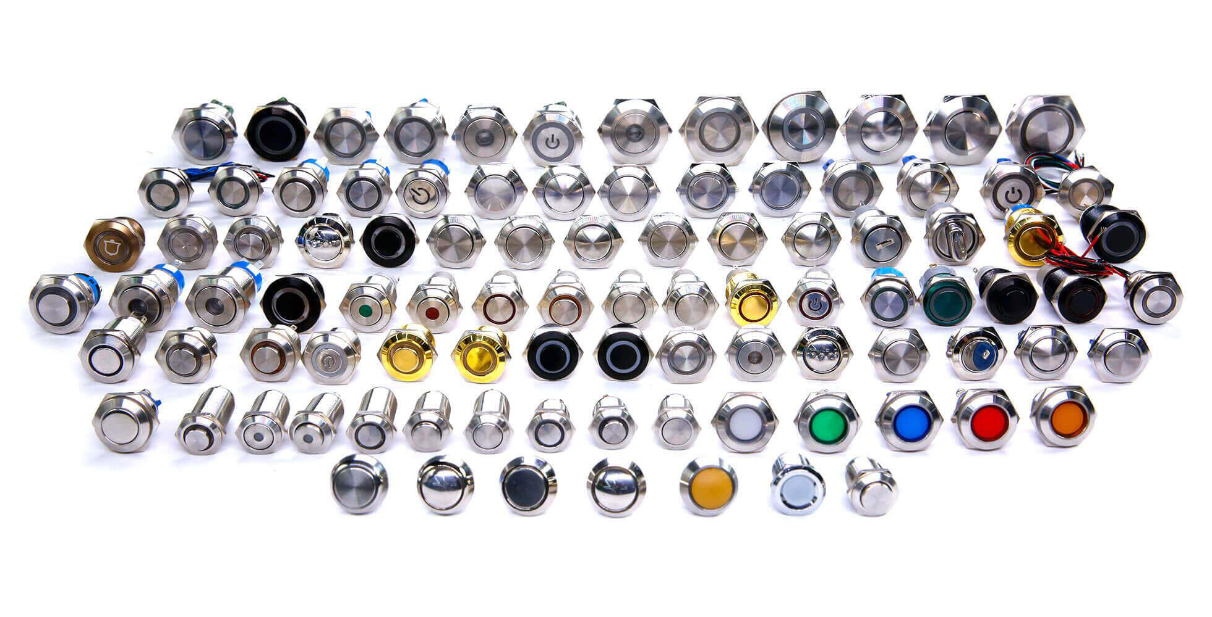
PUSH BUTTON SWITCH SERIES

Slide 13
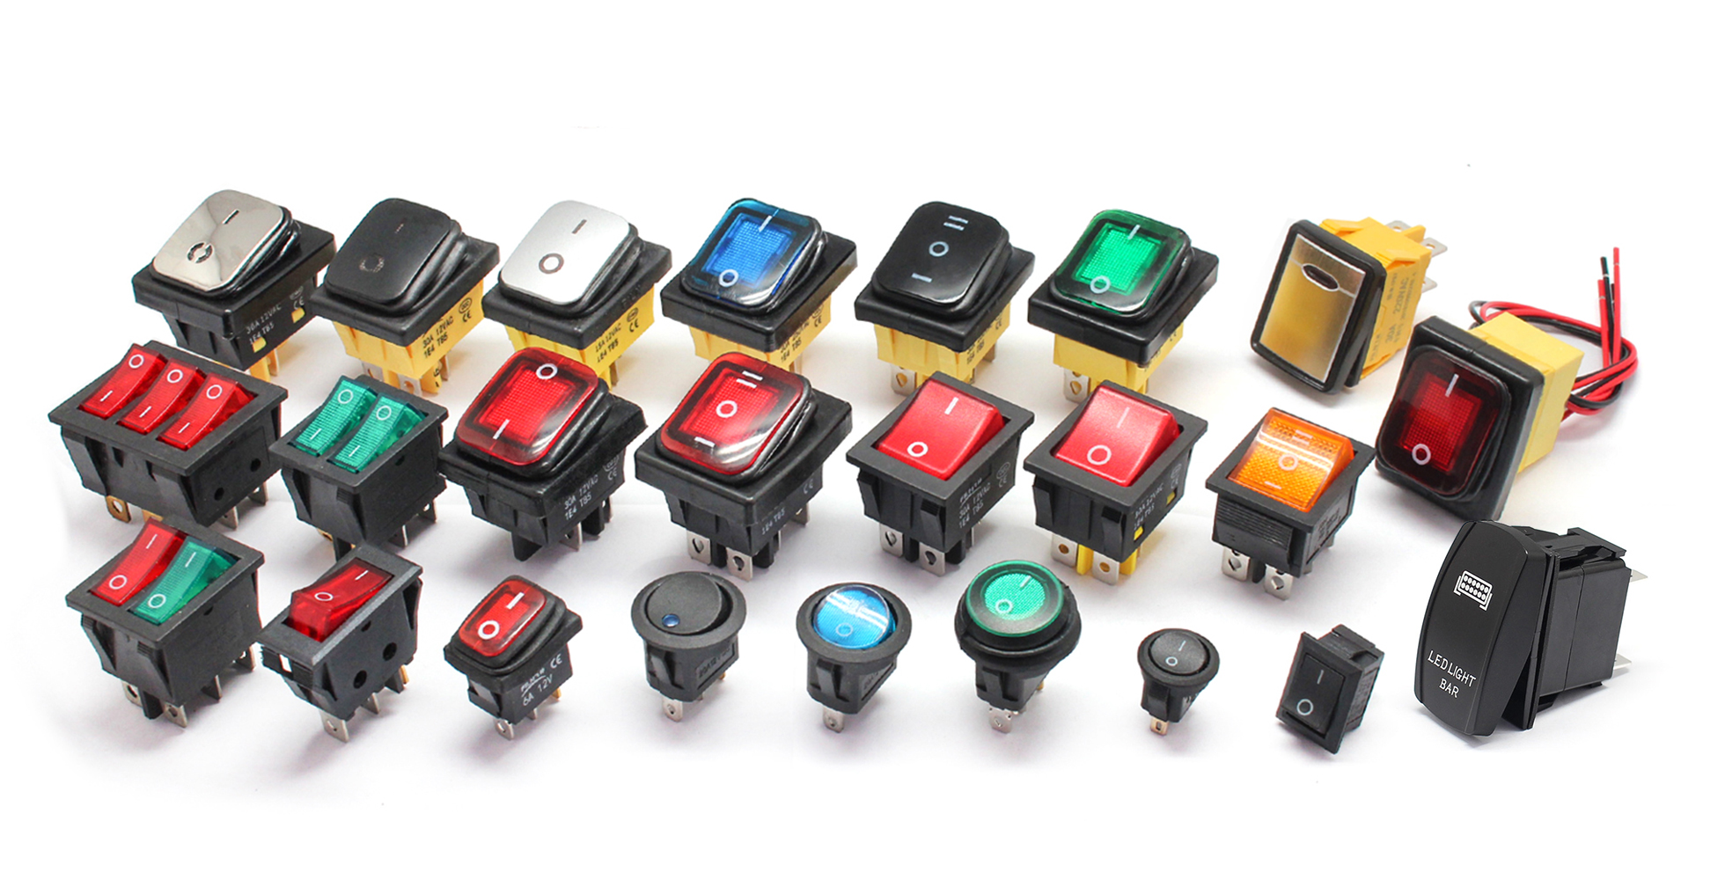
ROCKER SWITCH SERIES

