Slide 1
PRODUCT PORTFOLIO
DISTRIBUTION
DISTRIBUTION
Industrial Business Unit
Armando Bañón
March 8th 2024

Slide 2
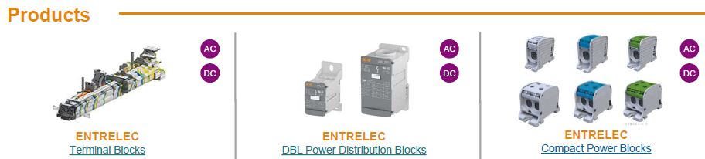
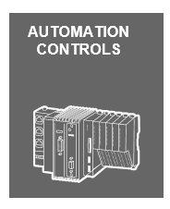

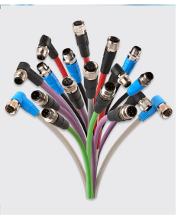
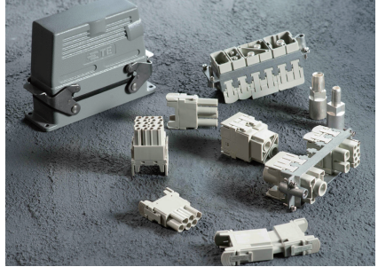
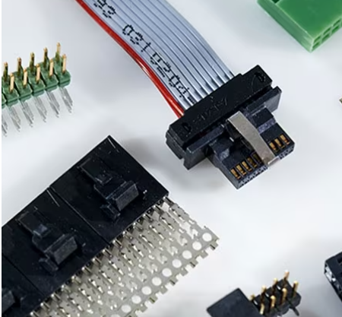
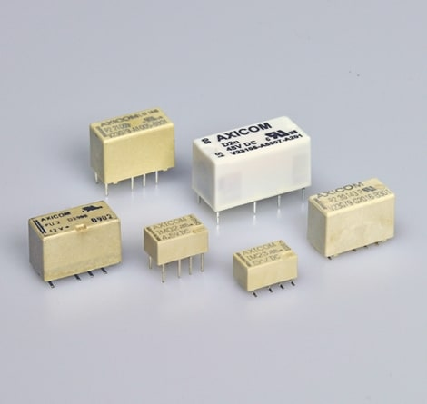
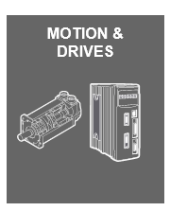

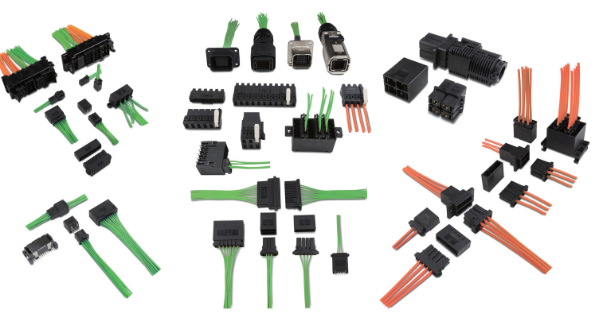
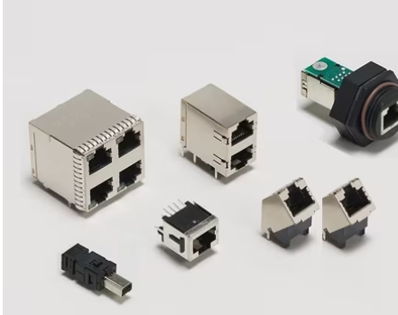
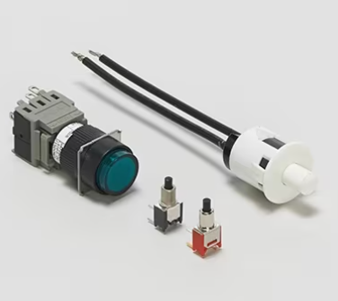
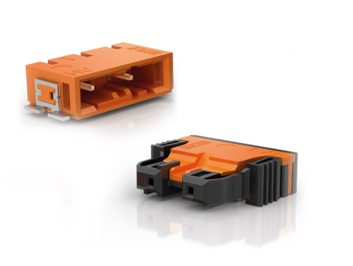
AFG‘S & PRODUCTS (1)
NEW
Industrial automation:
CPC ‘s
RPC’s
AMPMODU
RELAYS
DYNAMIC. RITS
RJ 45
SWITCHES
Erni Voltron
Erni Industrial
NEW

Slide 3

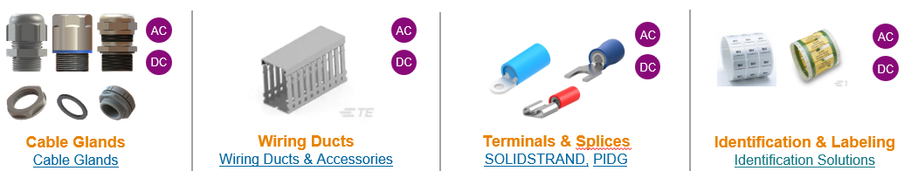
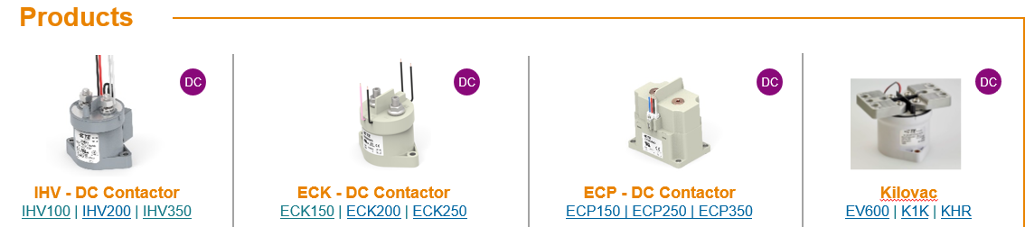
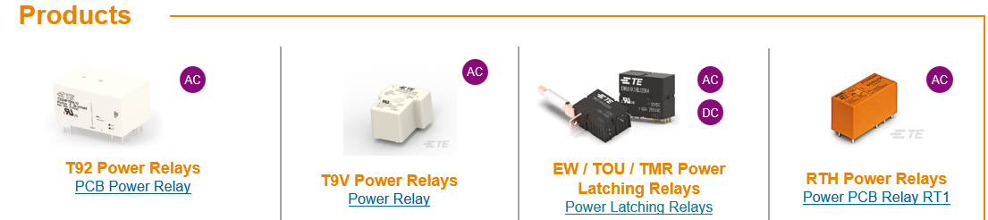
AFG‘S & PRODUCTS (2)
NEW
Bess & EVI
DC CHARGERS
NEW
AC CHARGERS

Slide 4
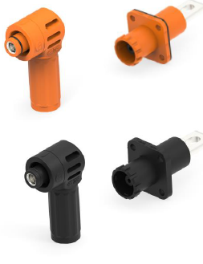
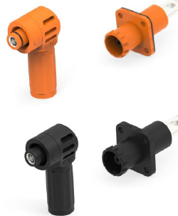
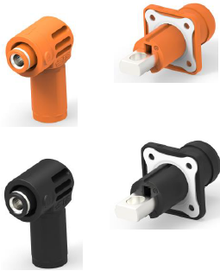
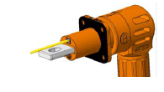
AFG‘S & PRODUCTS (3)
HDC BESS STACKED Connectors
Bess & EVI
HPC 200A
HPC 250A
HPC 350A
NEW

Slide 5
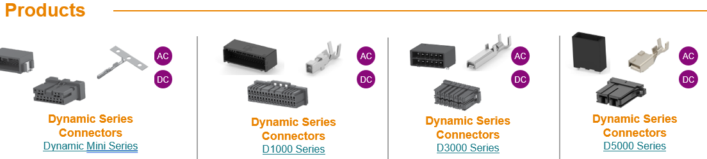
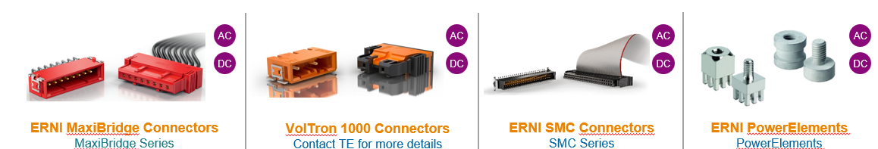
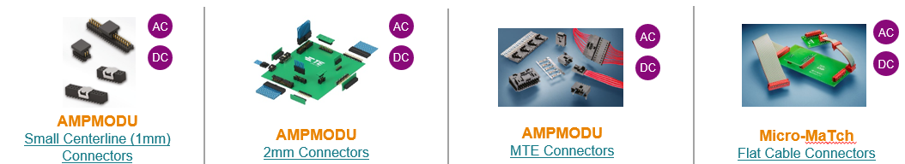
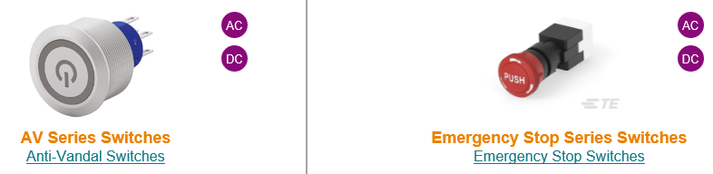
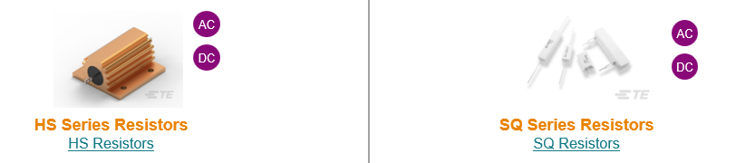
AFG‘S & PRODUCTS (4)
Board signal connectors
Bess & EVI:
Associated products
Switches
Power Resistors

Slide 6
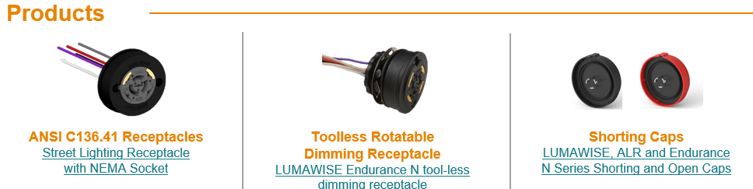




AFG‘S & PRODUCTS (5)
Outdoor lighting:
Nema
NEW
Zhaga
Accesories
NEW
Sensors

Slide 7
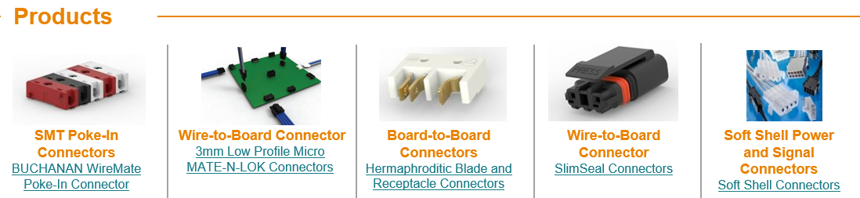

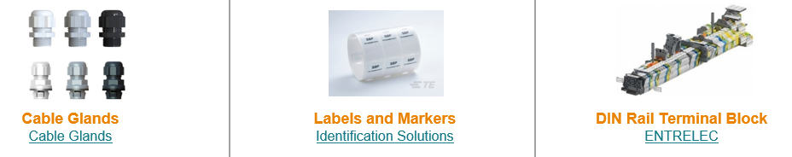
AFG‘S & PRODUCTS (6)
Outdoor lighting:
Associated products
NEW

